Slide 1
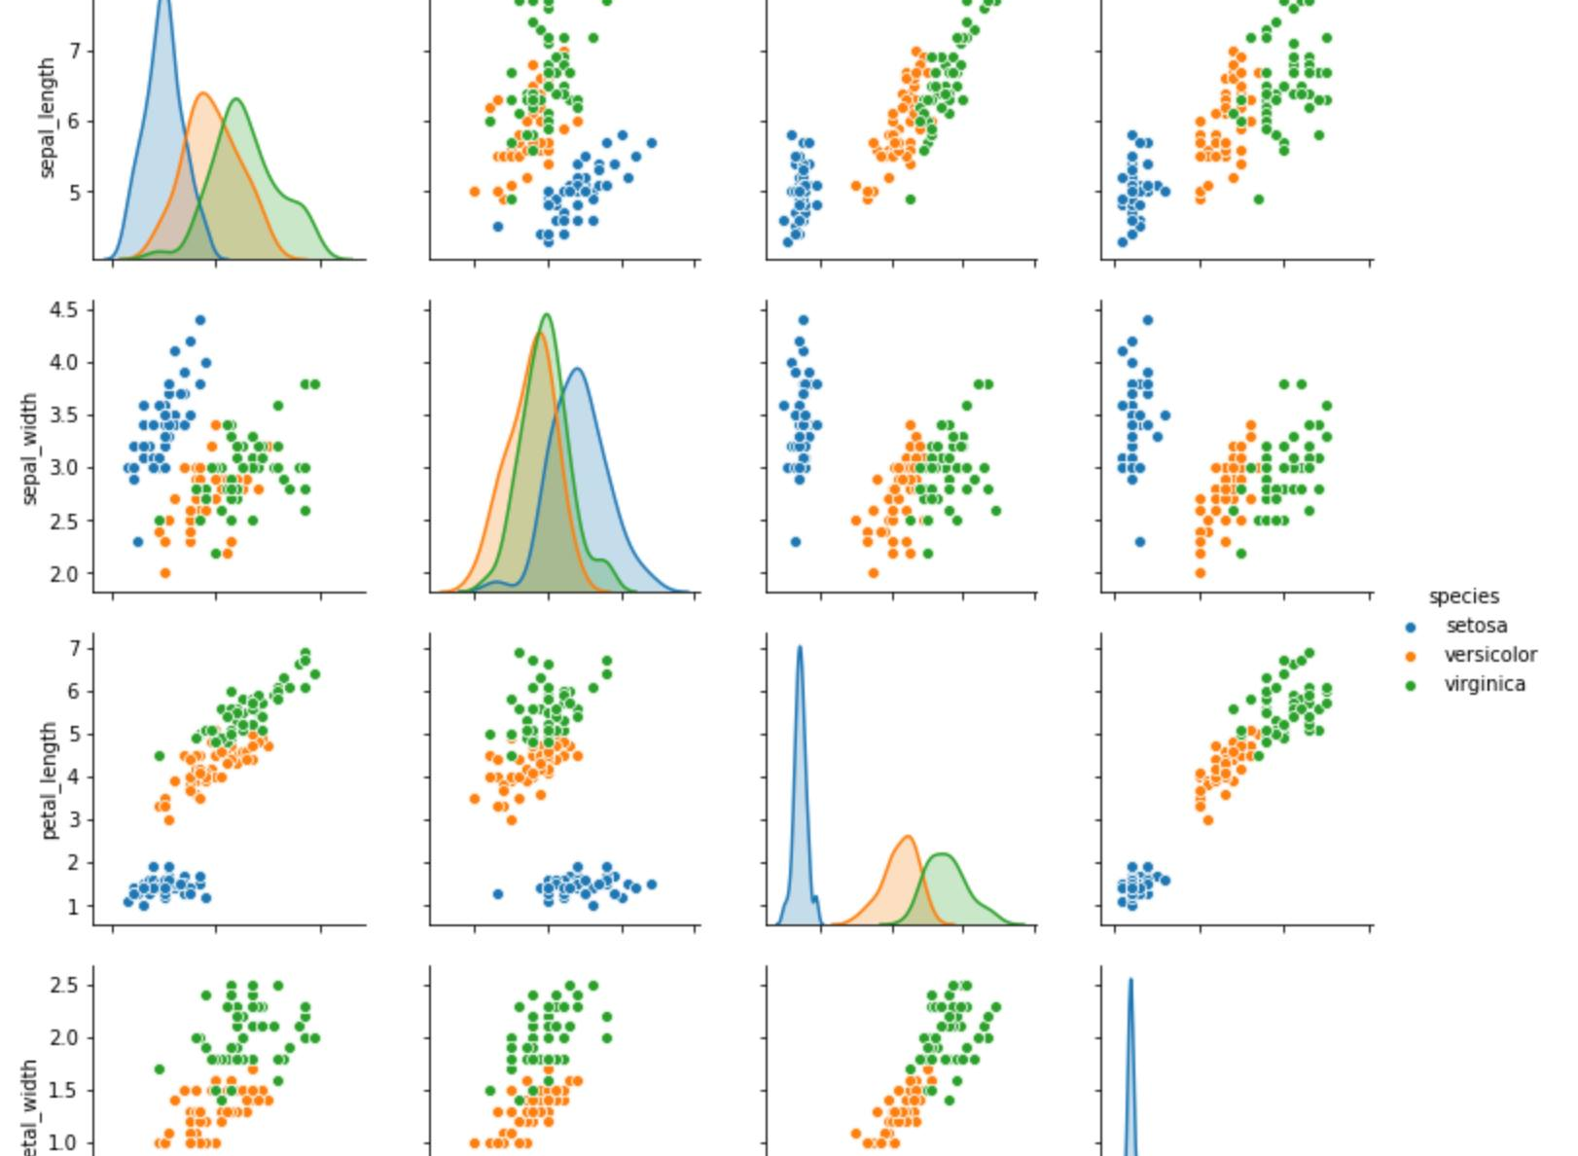
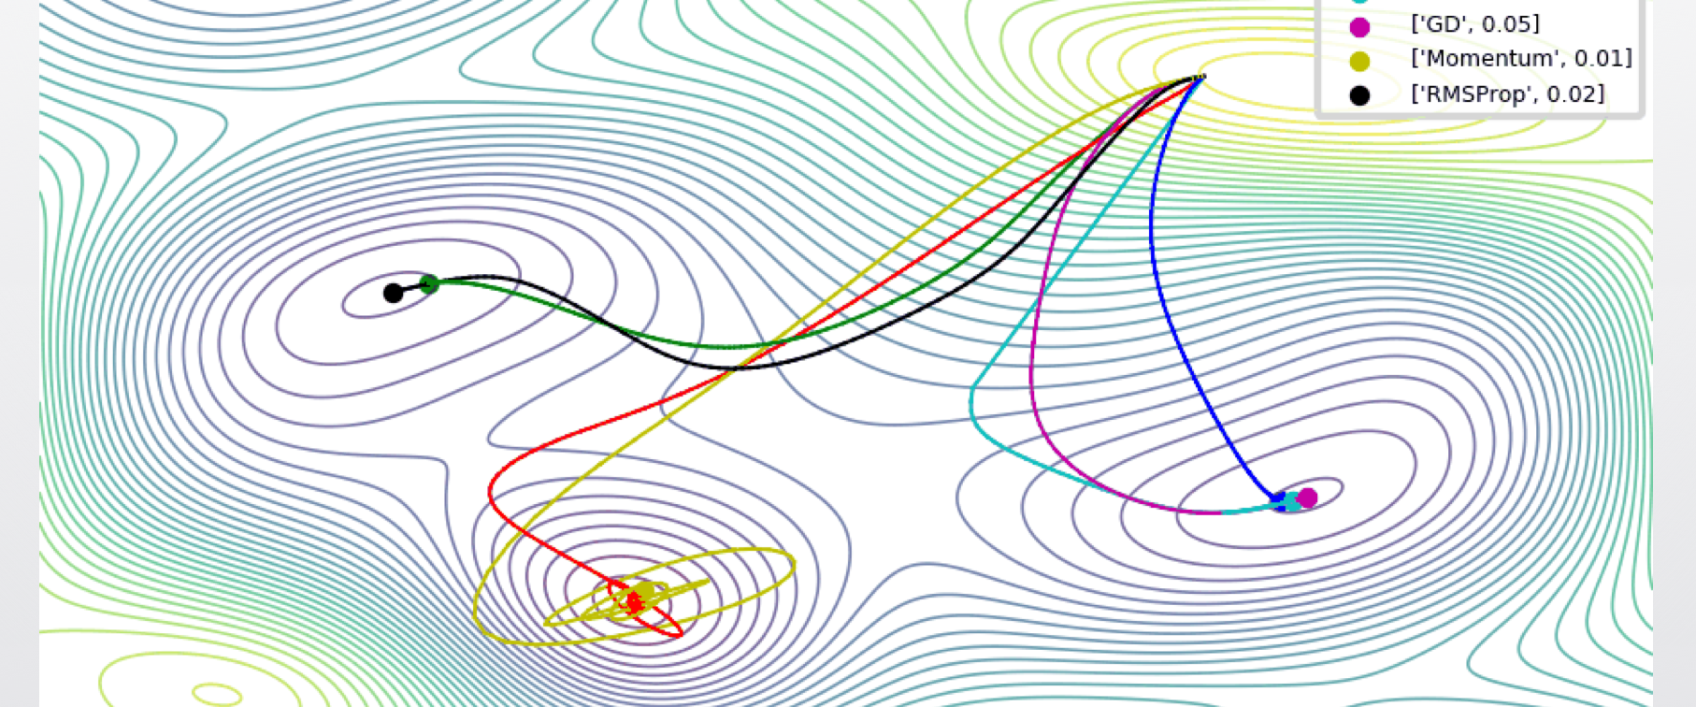
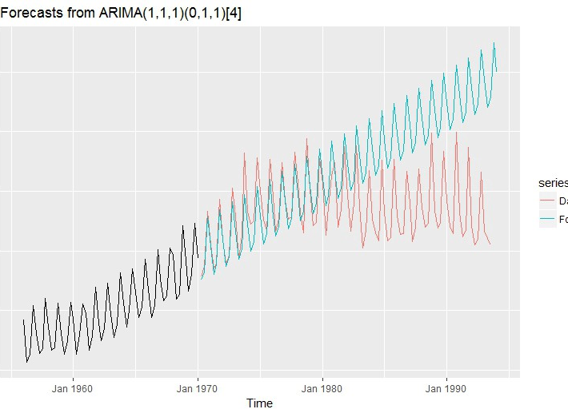
AIC, BIC and Alternatives to Out of Sample Testing – Chapter 7 ESL
Skander Hannachi

Slide 2
Is it possible to do away with the train/test split?
Small data scenarios
Automated model generation
Oracle RDF uses the BIC for model selection
Hyndman’s auto.arima() and ETS() use the AIC
Are there any other scenarios besides time series?

Slide 3
What are the possible approaches?
Analytical estimates of the out of sample error:
AIC, BIC, and other ICs
MDL (which is the same as the BIC ☺ )
VC dimension (Of SVM fame)
Direct estimates of the out of sample error:
Cross-Validation
Boot-Strapping

Slide 4
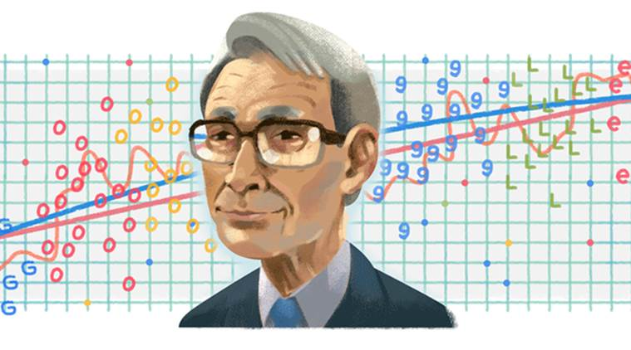
AIC: Akaike’s Information Criteria
赤池 弘次 Akaike Hirotsugu
Two ways of looking at it:
Hastie and friends: In Sample error as an estimate of Out of Sample error
Akaike’s original derivation: Information theoretical approach

Slide 5
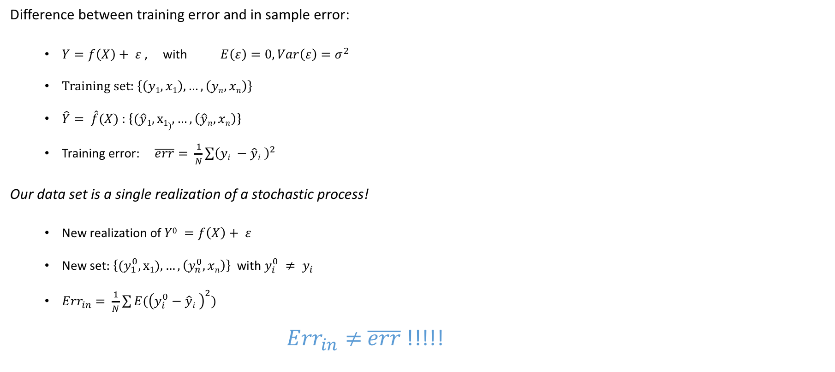
AIC 1: Hastie and friends - In Sample error as an estimate of Out of Sample error
Difference between training error and in sample error:
$Y=f\left(X\right)+ ε$ , with $E\left(ε\right)=0,Var\left(ε\right)=σ^{2}$
Training set: $\left\{\left(y1,x1\right),…,\left(yn,xn\right)\right\}$
$\hat{Y}= \hat{f}(X)$ : $\left\{(\hat{y}1,x1),…,\left(\hat{y}n,xn\right)\right\}$
Training error: $\overline{err}= \frac{1}{N}\sum{{\left(yi −\hat{y}i \right)}^{2}}$
Our data set is a single realization of a stochastic process!
New realization of $Y0 =f\left(X\right)+ ε$
New set: $\left\{(y_{1}^{0},x1),…,\left(y_{n}^{0},xn\right)\right\}$ with $y_{i}^{0} ≠ y_{i}$
${Err}_{in}$ $= \frac{1}{N}\sum{{E(\left(y_{i}^{0}−\hat{y}i \right)}^{2})}$
${Err}_{in}≠$ $\overline{err}$!!!!!

Slide 6
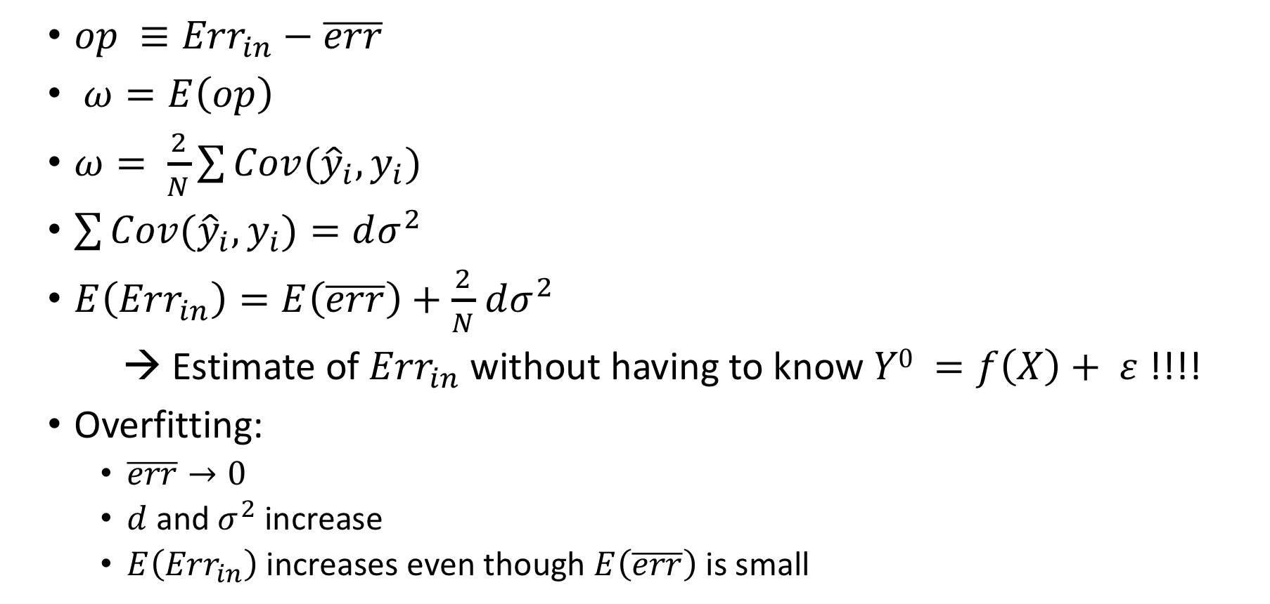
Optimism of the training error: Linear, Gaussian, etc…
${op ≡Err}_{in}−$ $\overline{err}$
$ω=E\left(op\right)$
$ω= \frac{2}{N}\sum{Cov({\hat{y}}_{i},y_{i})}$
$\sum{Cov({\hat{y}}_{i},y_{i})}=dσ^{2}$
$E\left({Err}_{in}\right)=E\left(\overline{err}\right)+$ $\frac{2}{N}$ $dσ^{2}$
→ Estimate of ${Err}_{in}$without having to know $Y0 =f\left(X\right)+ ε$ !!!!
Overfitting:
$\overline{err}→0$
$d$ and $σ^{2}$ increase
$E\left({Err}_{in}\right)$ increases even though $E\left(\overline{err}\right)$ is small

Slide 7
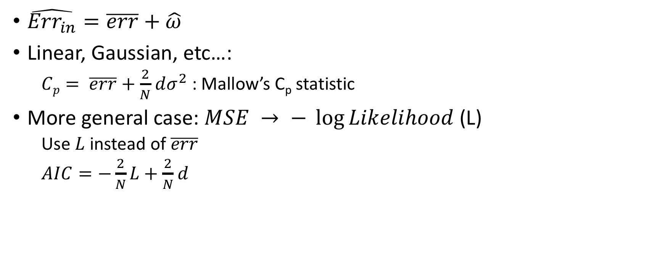
Optimism of the training error: In practice
$\hat{{Err}_{in}}=\overline{err}+\hat{ω}$
Linear, Gaussian, etc…:
$Cp= \overline{err}+$ $\frac{2}{N}$ $dσ^{2}$ : Mallow’s C_{p} statistic
More general case: $MSE → − \log{Likelihood}$ (L)
Use $L$instead of $\overline{err}$
$AIC=−\frac{2}{N}L+$ $\frac{2}{N}$ $d$

Slide 8
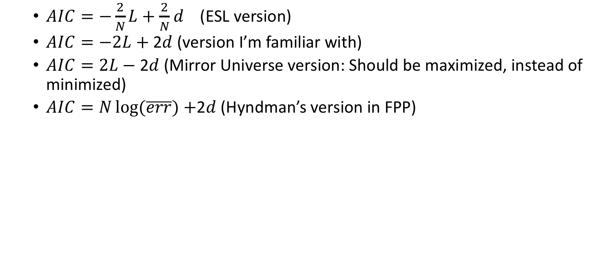
AIC: Many variations
$AIC=−\frac{2}{N}L+$ $\frac{2}{N}$ $d$ (ESL version)
$AIC=−2L+$ 2$d$ (version I’m familiar with)
$AIC=2L−$ 2$d$ (Mirror Universe version: Should be maximized, instead of minimized)
$AIC=N\log{(\overline{err})}+$2$d$ (Hyndman’s version in FPP)

Slide 9
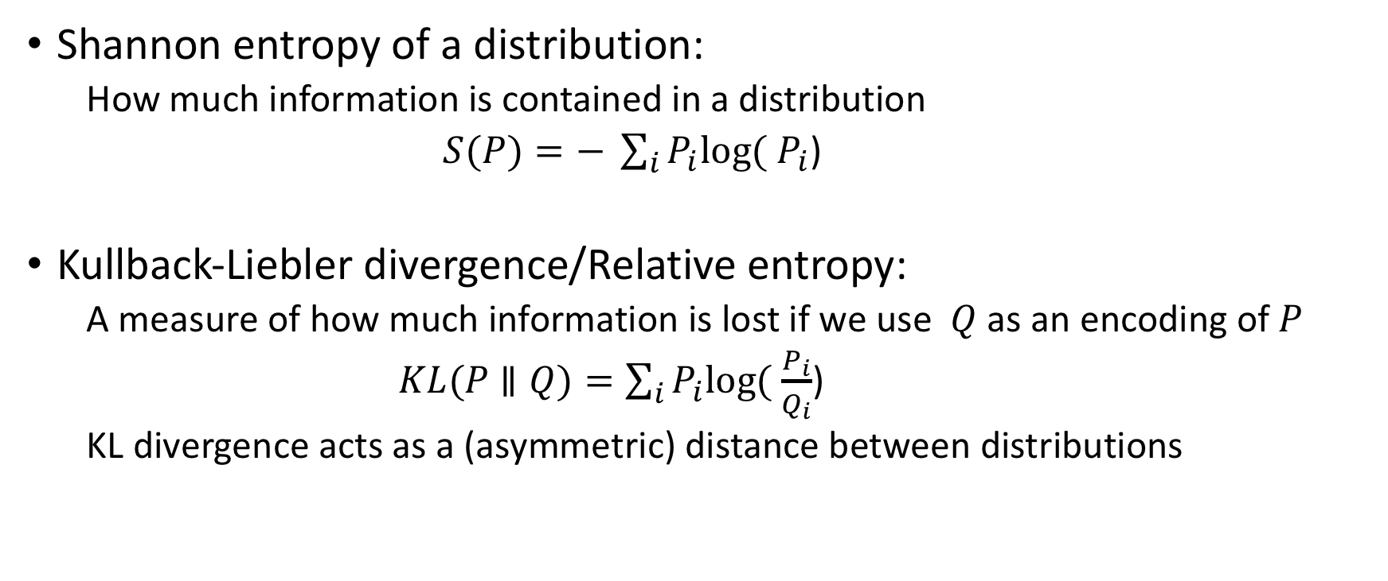
AIC 2: Information Theoretical Approach (i.e. the fun version!)
Shannon entropy of a distribution:
How much information is contained in a distribution
$S(P)=− \sum_{i}{P_{i}log⁡(}$ $P_{i}$)
Kullback-Liebler divergence/Relative entropy:
A measure of how much information is lost if we use $Q$as an encoding of $P$
$KL(P$ $∥Q)=\sum_{i}{P_{i}log⁡(}$ $\frac{P_{i}}{Q_{i}}$)
KL divergence acts as a (asymmetric) distance between distributions

Slide 10

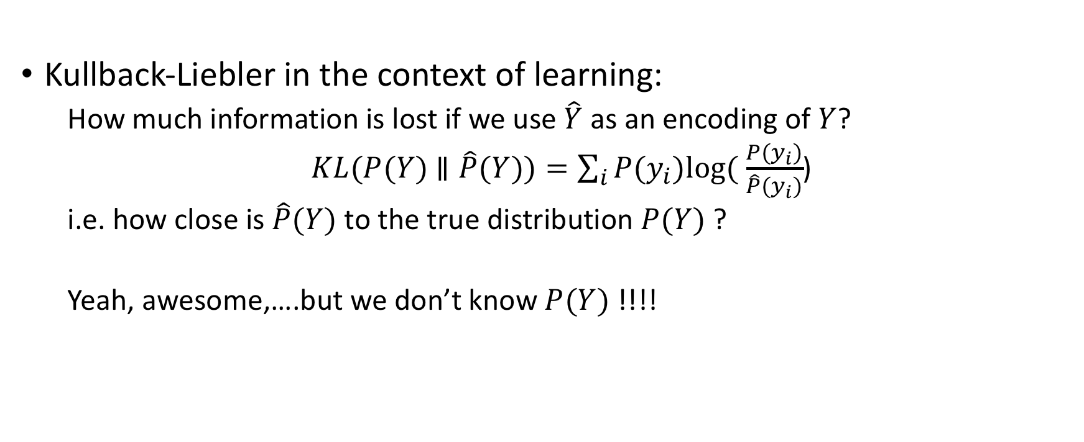
AIC 2: KL divergence as a measure of goodness of fit
Kullback-Liebler in the context of learning:
How much information is lost if we use $\hat{Y}$ as an encoding of $Y$?
$KL(P(Y)$ $∥\hat{P}(Y))=\sum_{i}{{P(y}_{i})log⁡(}$ $\frac{{P(y}_{i})}{\hat{P}{(y}_{i})}$)
i.e. how close is $\hat{P}(Y)$ to the true distribution $P(Y)$ ?
Yeah, awesome,….but we don’t know $P(Y)$ !!!!
I find your lack of faith disturbing…

Slide 11
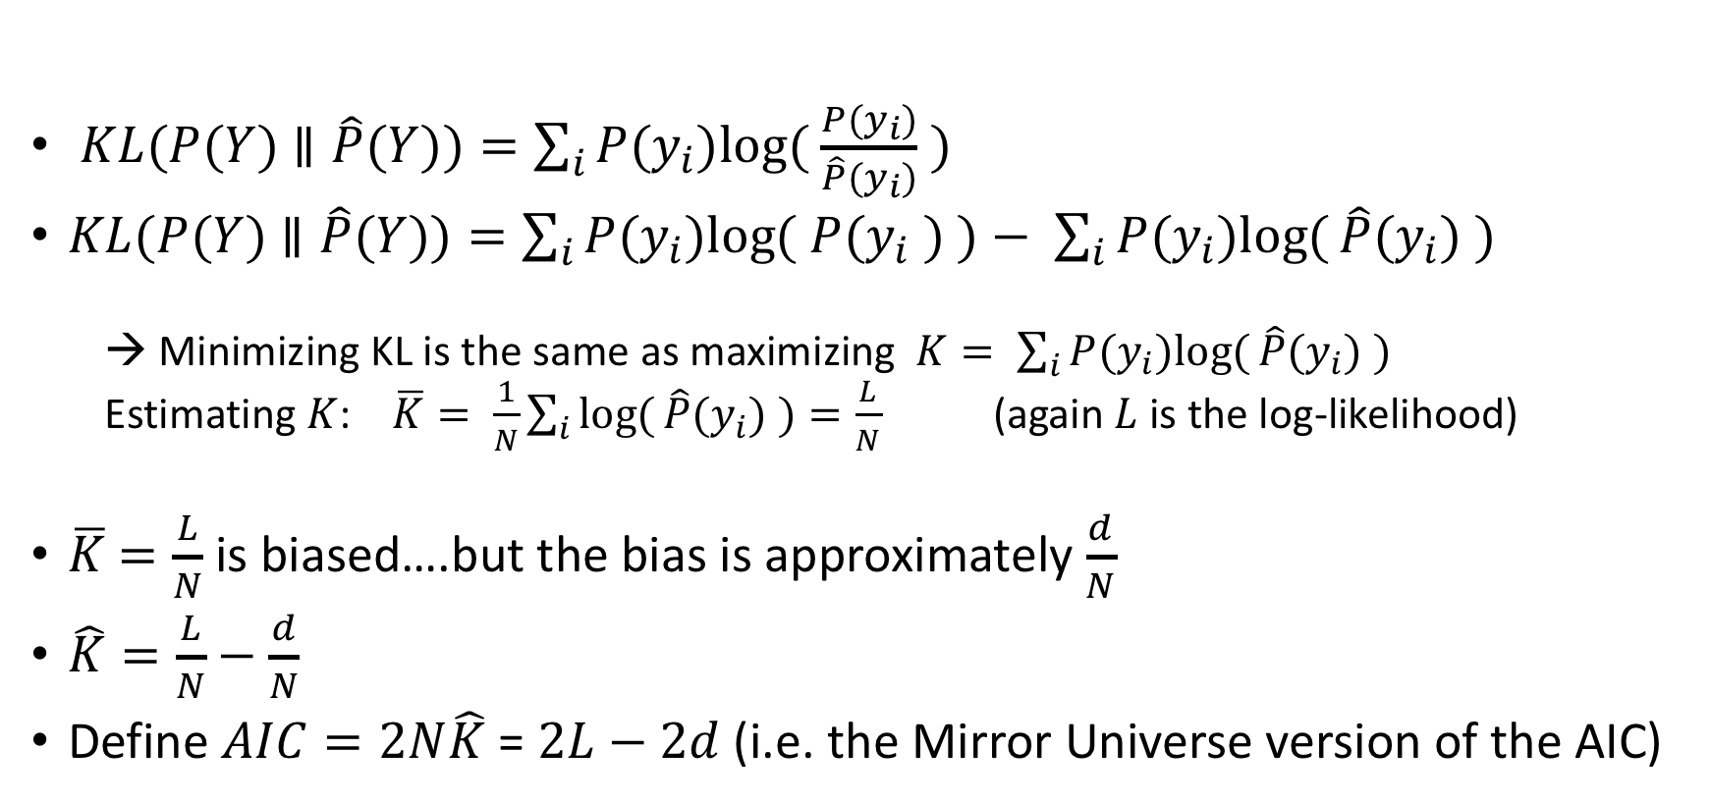
AIC 2: Finding the minimum KL without knowing it
$KL(P(Y)$ $∥\hat{P}(Y))=\sum_{i}{{P(y}_{i})log⁡(}$ $\frac{{P(y}_{i})}{\hat{P}{(y}_{i})}$ $)$
$KL(P(Y)$ $∥\hat{P}(Y))=\sum_{i}{{P(y}_{i})log⁡(}$ ${P(y}_{i}$ $)$ $)− \sum_{i}{{P(y}_{i})log⁡(}\hat{P}{(y}_{i})$ $)$
→ Minimizing KL is the same as maximizing $K= \sum_{i}{{P(y}_{i})log⁡(}\hat{P}{(y}_{i})$ $)$
Estimating $K$: $\overline{K}= \frac{1}{N}\sum_{i}{log⁡(}\hat{P}{(y}_{i})$ $)=\frac{L}{N}$ (again $L$ is the log-likelihood)
$\overline{K}$ $=\frac{L}{N}$ is biased….but the bias is approximately $\frac{d}{N}$
$\hat{K}=\frac{L}{N}−\frac{d}{N}$
Define $AIC=2N\hat{K}$ = $2L−2d$ (i.e. the Mirror Universe version of the AIC)

Slide 12
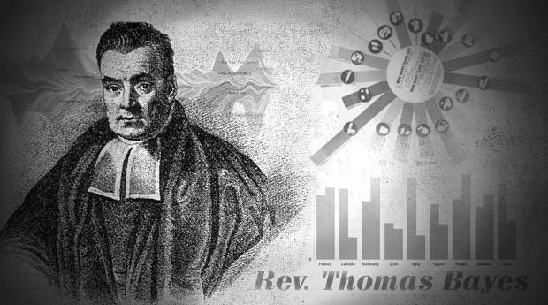
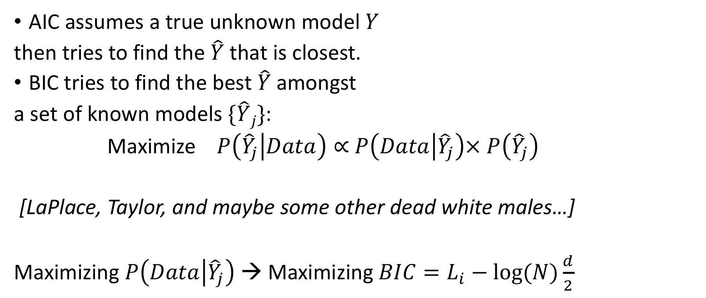
Enter the Reverend: The Bayesian Information Criteria
AIC assumes a true unknown model $Y$
then tries to find the $\hat{Y}$that is closest.
BIC tries to find the best $\hat{Y}$amongst
a set of known models $\{\hat{Y}j\}$:
Maximize $P\left({\hat{Y}}_{j} | Data\right)∝$ $P\left(Data | {\hat{Y}}_{j}\right)×$ $P\left({\hat{Y}}_{j}\right)$
[LaPlace, Taylor, and maybe some other dead white males…]
Maximizing $P\left(Data | {\hat{Y}}_{j}\right)$ → Maximizing $BIC=L_{i}−log⁡(N)\frac{d}{2}$

Slide 13
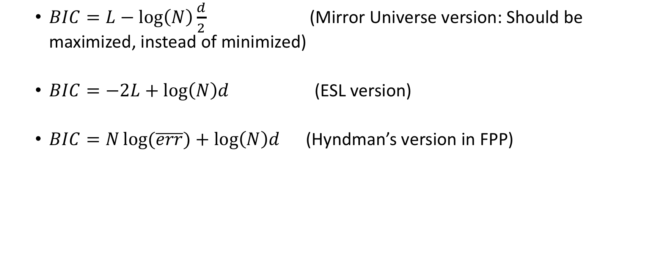
BIC: Many variations
$BIC=L−\log\left(N\right)\frac{d}{2}$ (Mirror Universe version: Should be maximized, instead of minimized)
$BIC=−2L+\log\left(N\right)d$ (ESL version)
$BIC=N\log{(\overline{err})}+\log\left(N\right)d$ (Hyndman’s version in FPP)

Slide 14
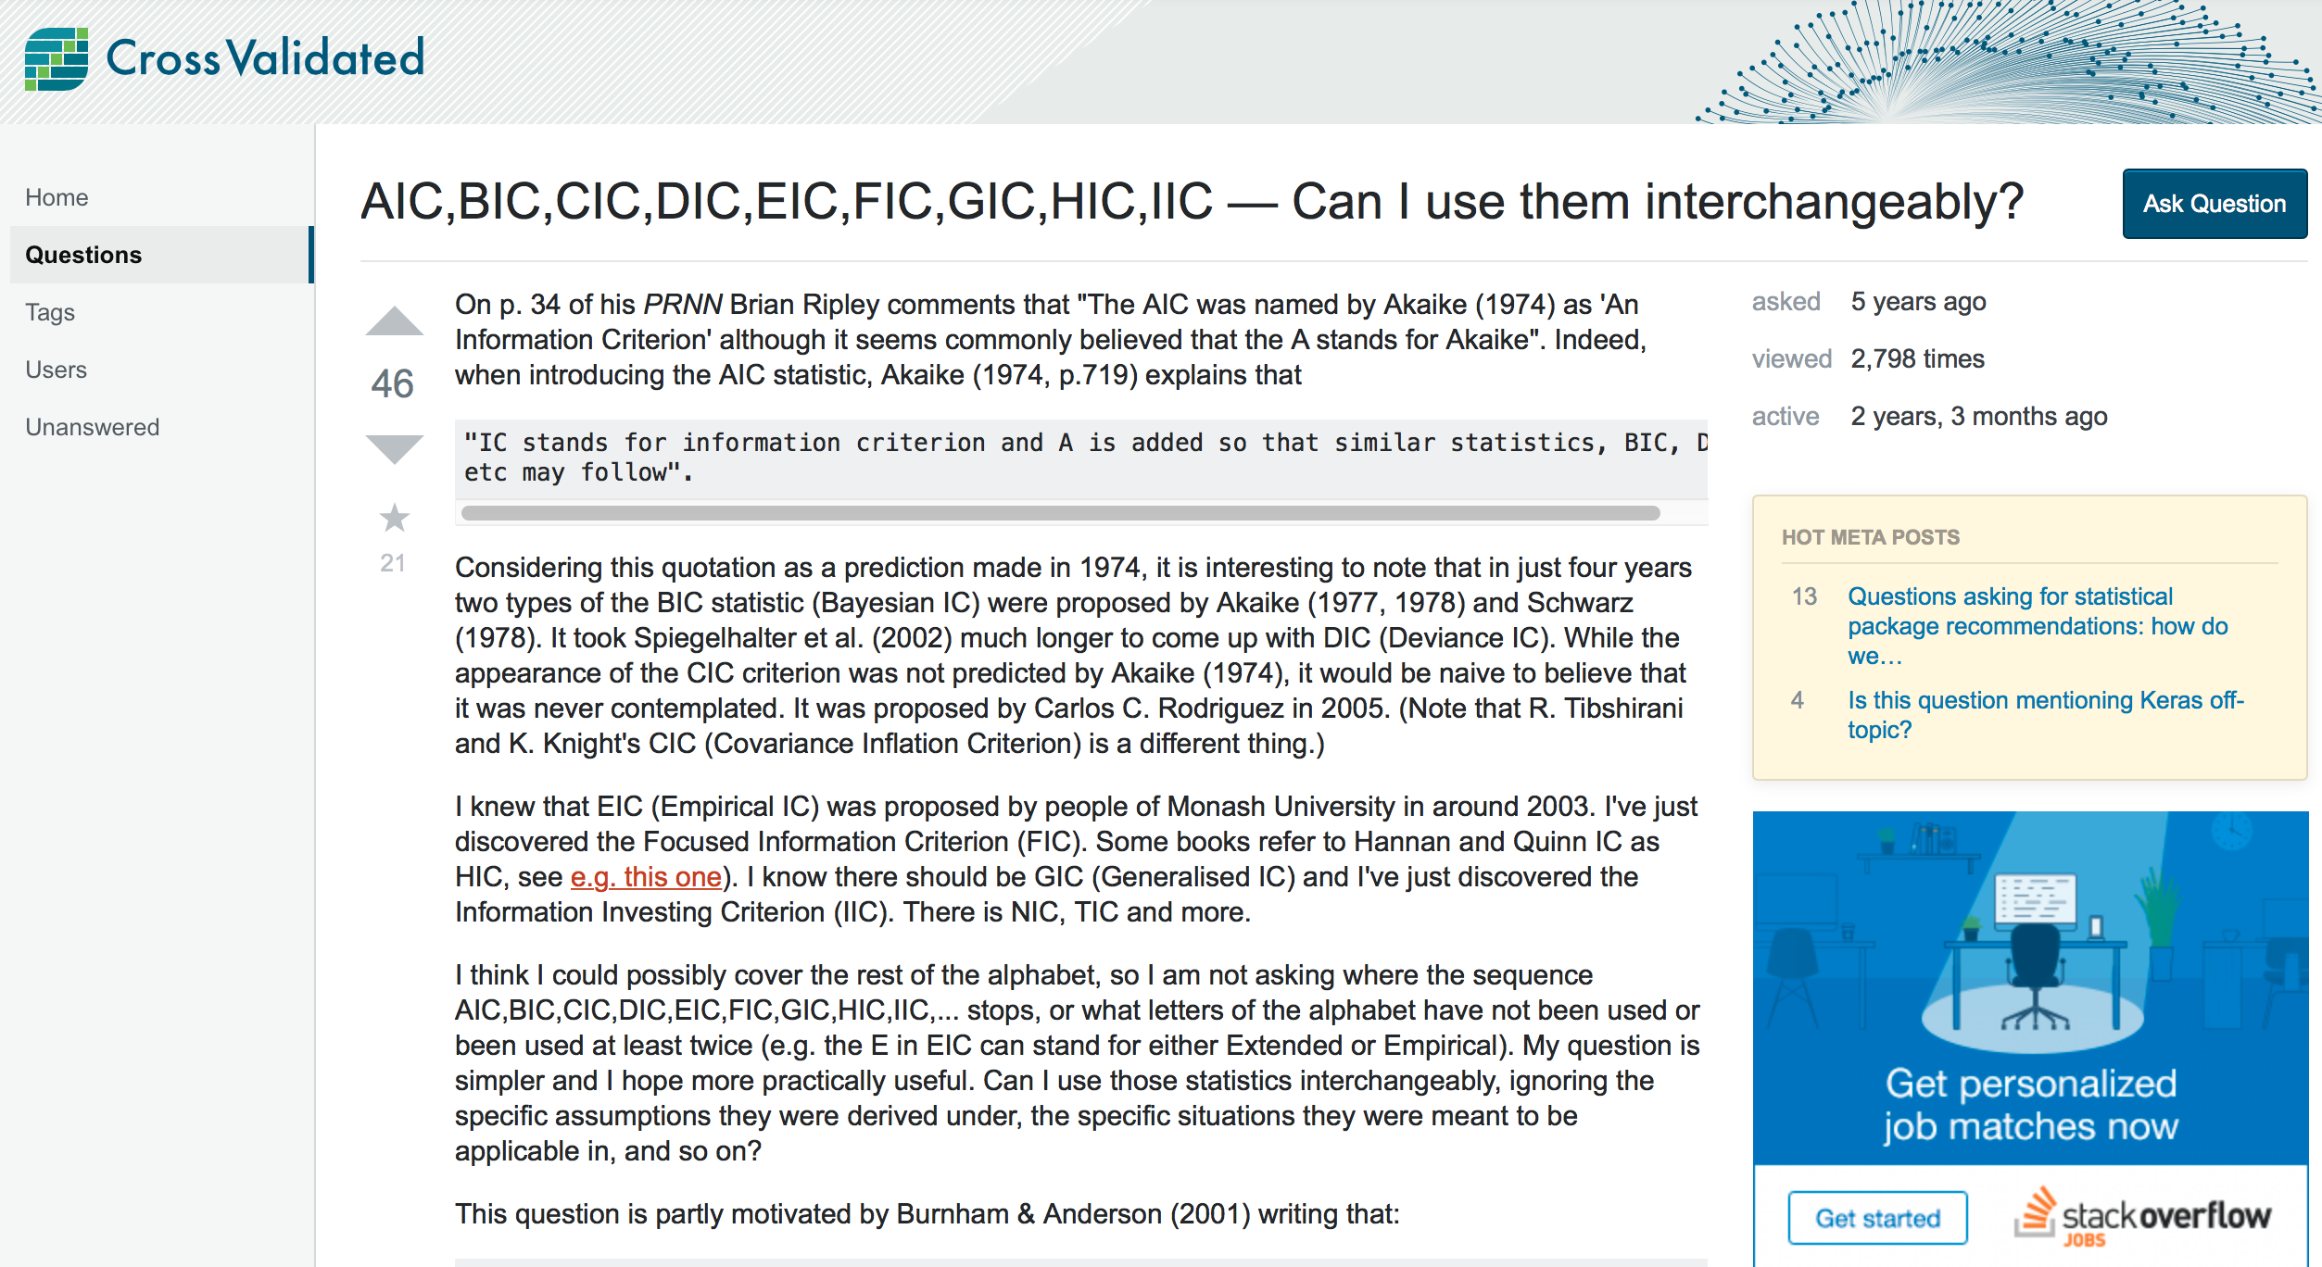
The Information Criterion Zoo:

Slide 15

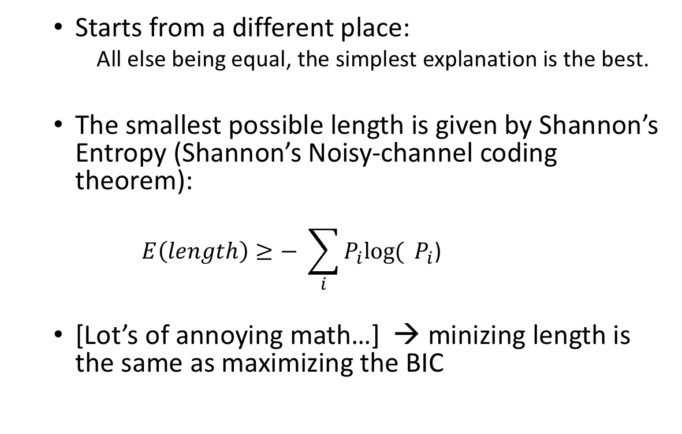
MDL: Another information theoretic approach
Starts from a different place:
All else being equal, the simplest explanation is the best.
The smallest possible length is given by Shannon’s Entropy (Shannon’s Noisy-channel coding theorem):
$$E\left(length\right)≥− \sum_{i}{P_{i}log⁡(} P_{i}\text{)}$$
[Lot’s of annoying math…] → minizing length is the same as maximizing the BIC

Slide 16
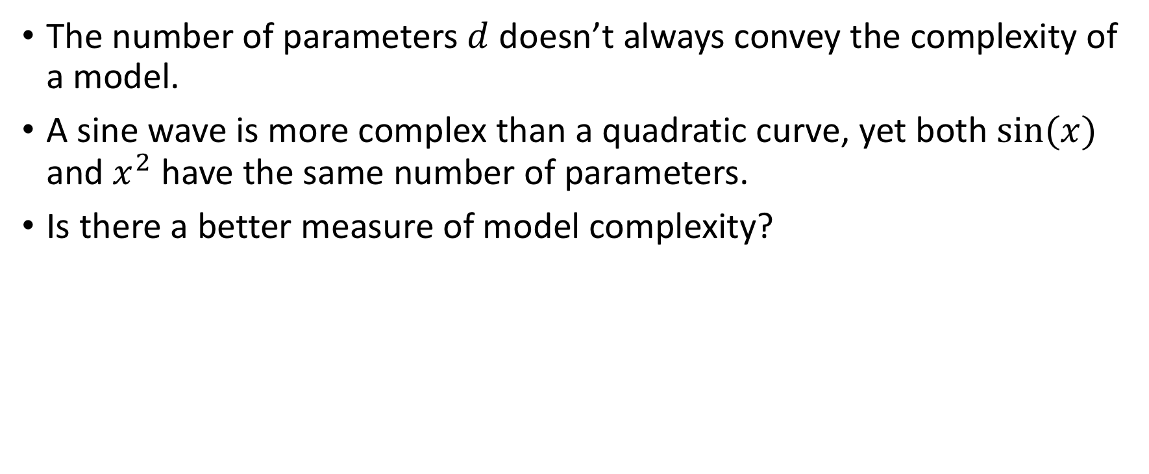
Vapnik-Chervonenkis dimension: Forget information theory, geometry rules!!!!
The number of parameters $d$ doesn’t always convey the complexity of a model.
A sine wave is more complex than a quadratic curve, yet both $sin⁡(x)$ and $x^{2}$ have the same number of parameters.
Is there a better measure of model complexity?

Slide 17
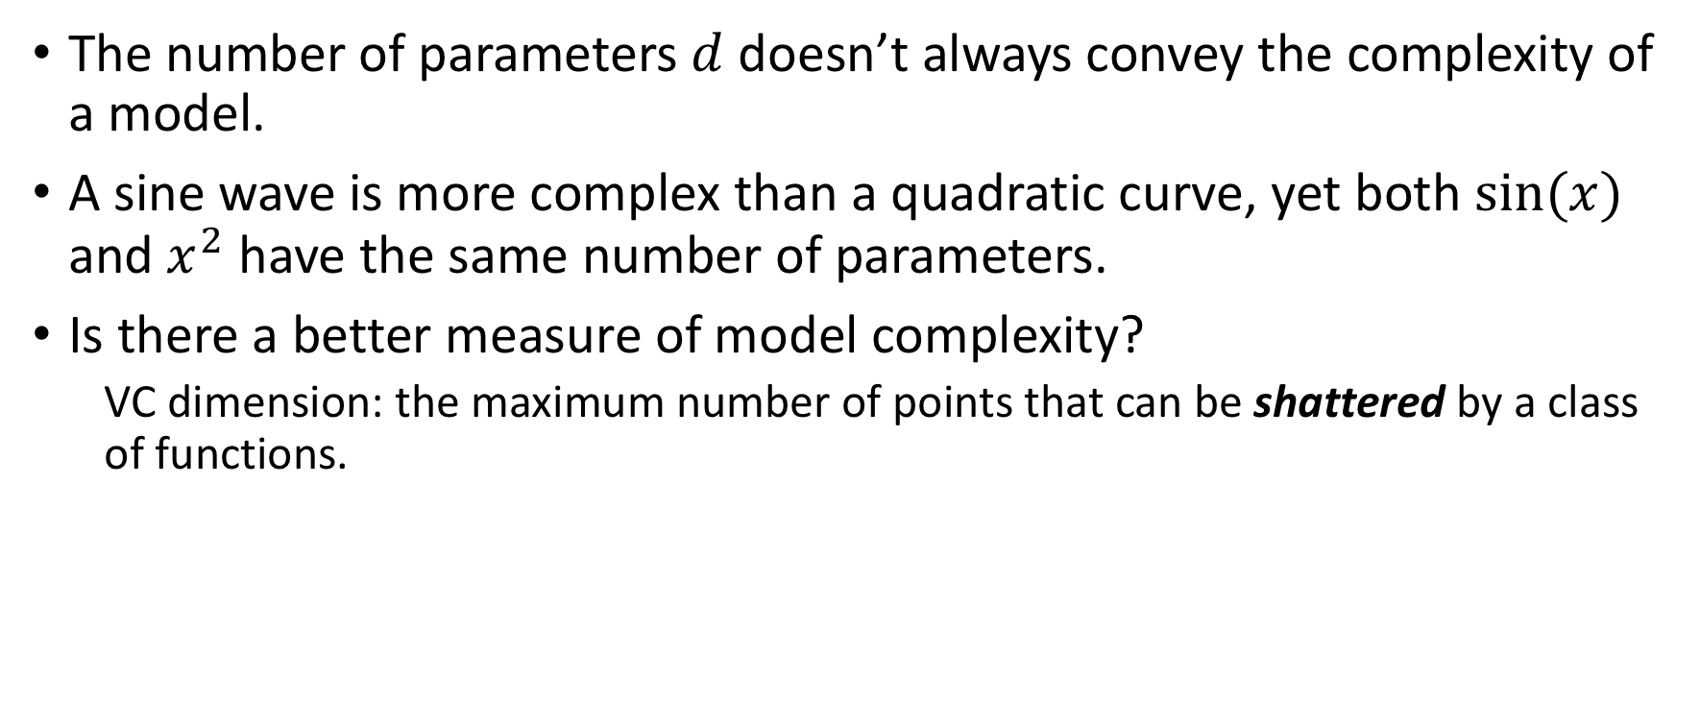
Vapnik-Chervonenkis dimension: Forget information theory, geometry rules!!!!
The number of parameters $d$ doesn’t always convey the complexity of a model.
A sine wave is more complex than a quadratic curve, yet both $sin⁡(x)$ and $x^{2}$ have the same number of parameters.
Is there a better measure of model complexity?
VC dimension: the maximum number of points that can be shattered by a class of functions.

Slide 18

Geometry: VC dimension of line
VC dimension of a line = 3 (Remember the XOR problem?)

Slide 19
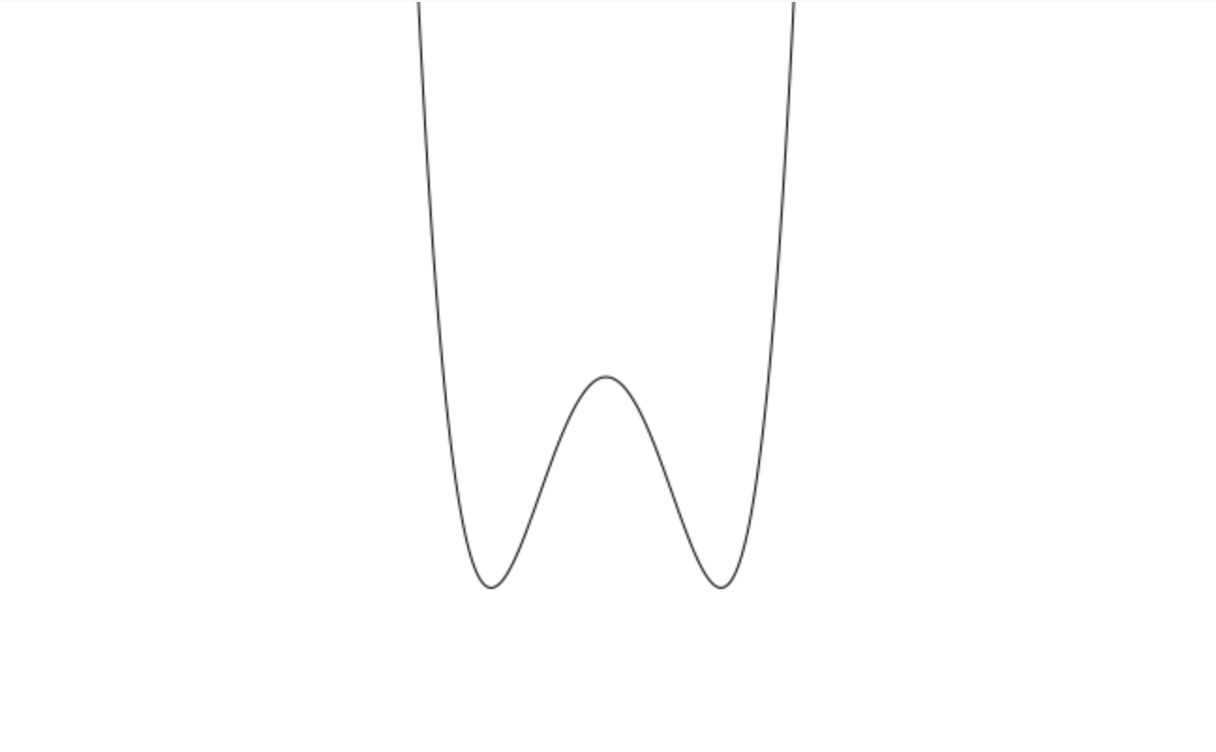
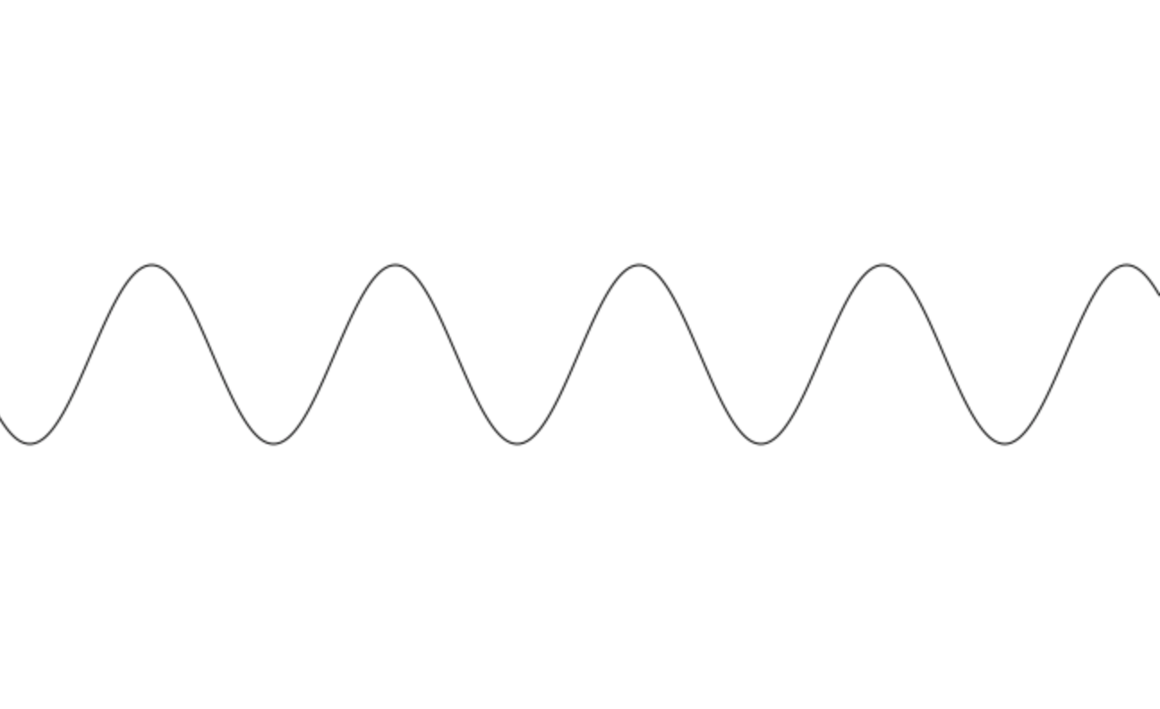
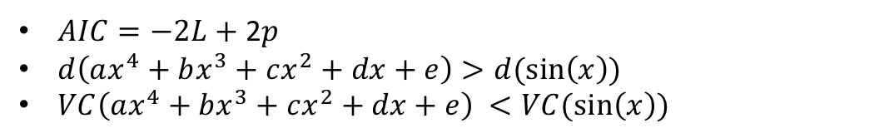
Geometry:
$AIC=−2L+$ 2$p$
$d\left(ax^{4}+bx^{3}+cx^{2}+dx+e\right)>d(\sin\left(x\right))$
$VC\left(ax^{4}+bx^{3}+cx^{2}+dx+e\right) <VC(\sin\left(x\right))$

Slide 20
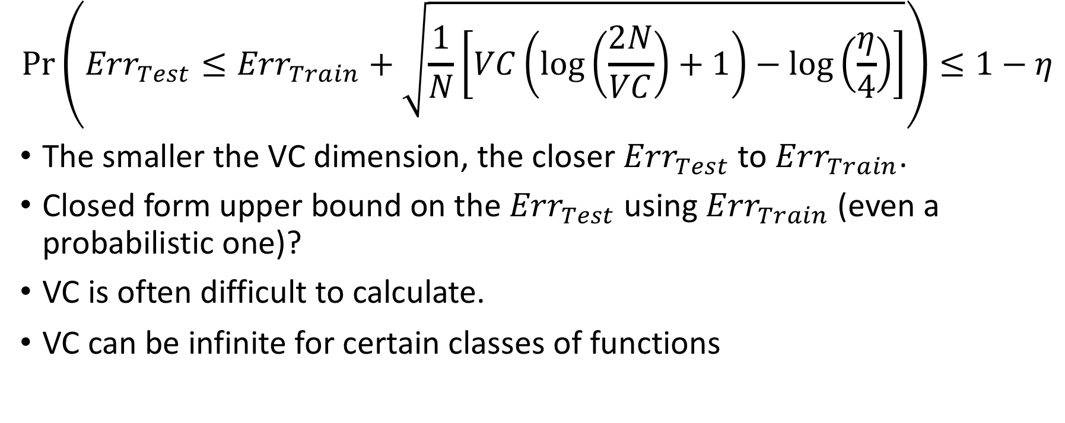
VC and the upper bound on test error:
$$\operatorname{Pr}\left({Err}_{Test}≤{Err}_{Train}+\sqrt{\frac{1}{N}\left[VC\left(\log\left(\frac{2N}{VC}\right)+1\right)−\log\left(\frac{η}{4}\right)\right]}\right)≤1−η$$
The smaller the VC dimension, the closer ${Err}_{Test}$ to ${Err}_{Train}$.
Closed form upper bound on the ${Err}_{Test}$ using ${Err}_{Train}$ (even a probabilistic one)?
VC is often difficult to calculate.
VC can be infinite for certain classes of functions

Slide 21
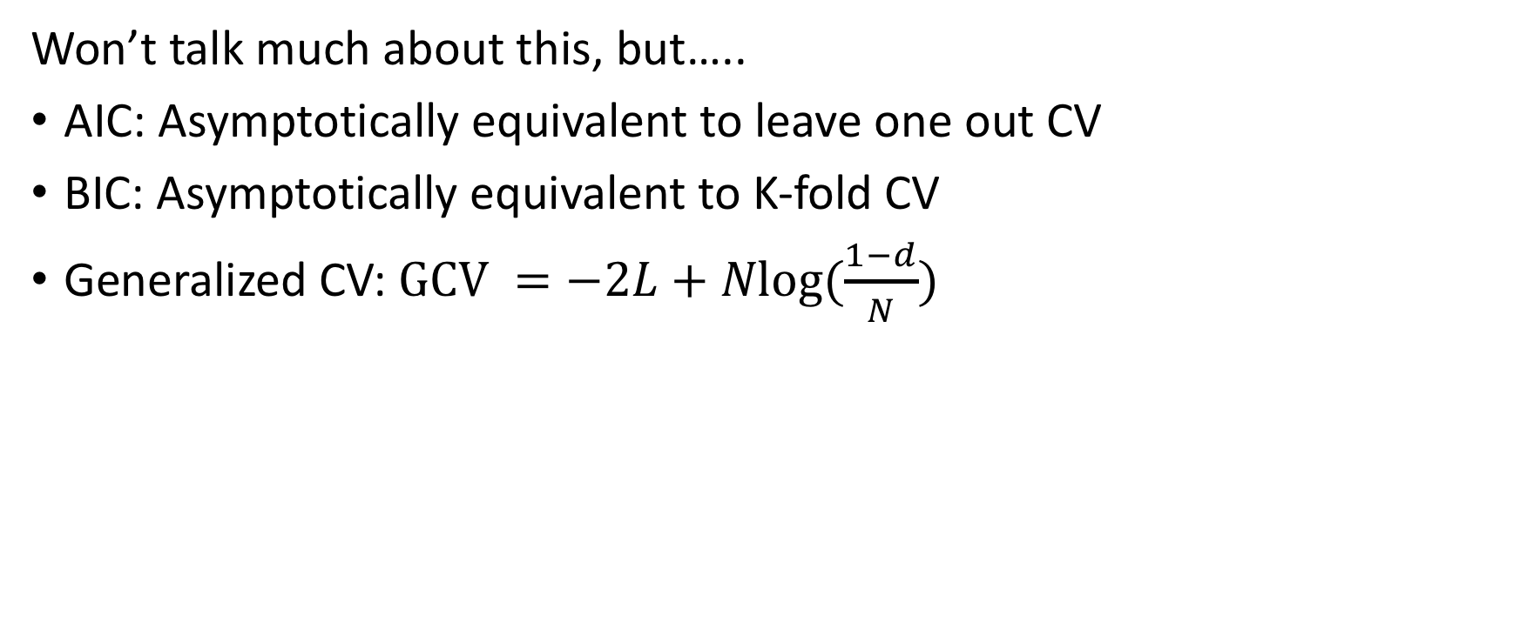
Cross-Validation and Bootstrapping
Won’t talk much about this, but…..
AIC: Asymptotically equivalent to leave one out CV
BIC: Asymptotically equivalent to K-fold CV
Generalized CV: $GCV =−2L+\operatorname{Nlog}{(\frac{1−d}{N})}$

Slide 22
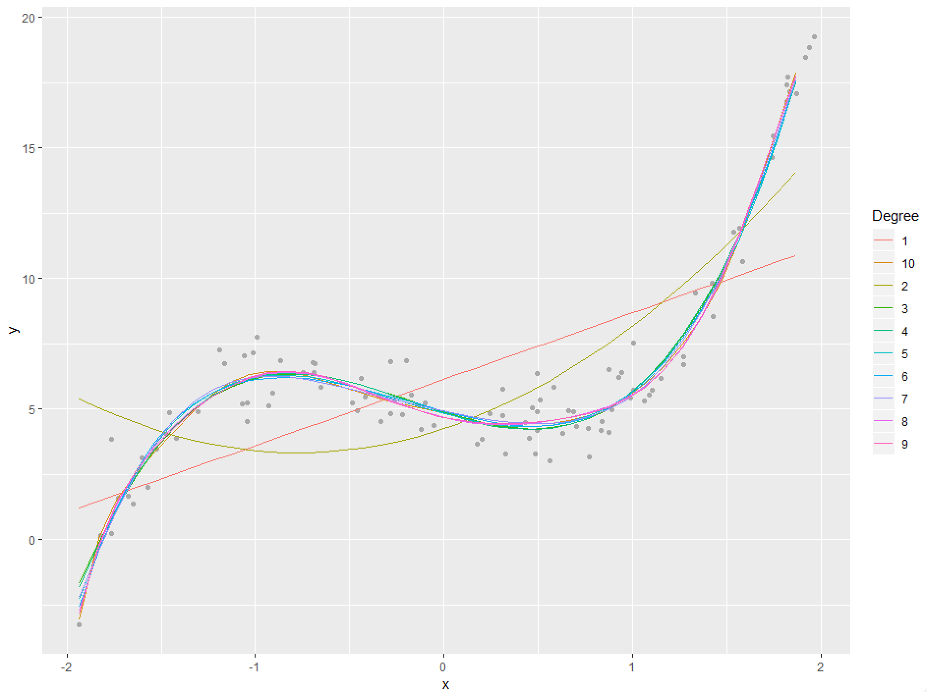
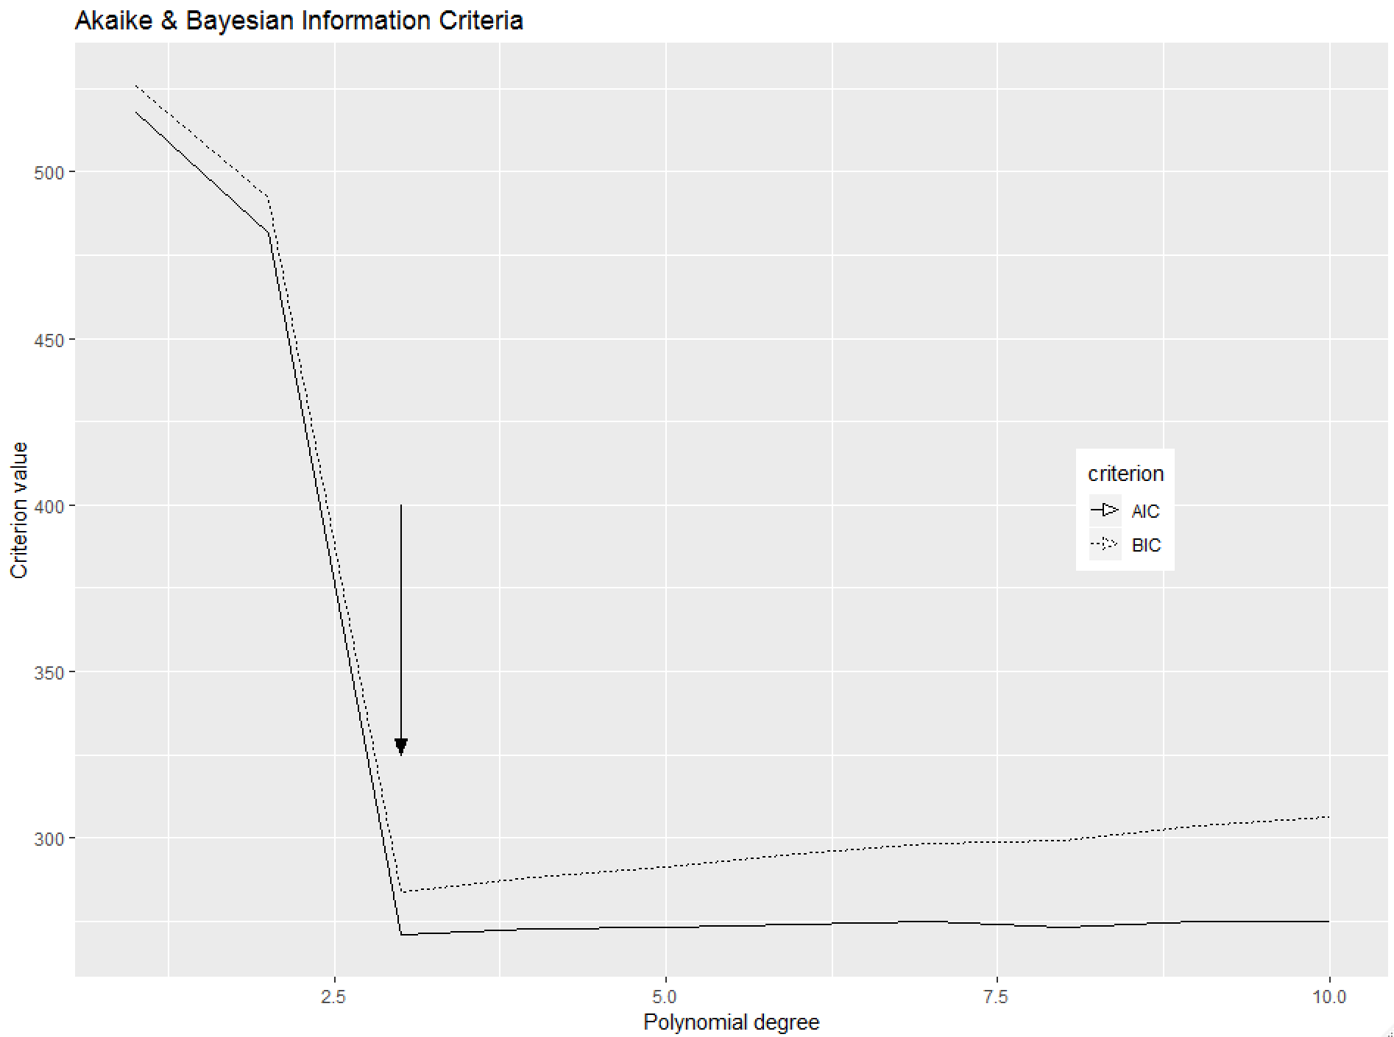
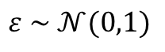
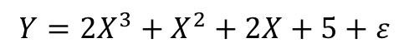
Practical examples: a good one (Originally from R Bloggers)
$$Y=2X^{3}+X^{2}+2X+5+ε$$
$$ε \sim 𝒩(0,1)$$

Slide 23
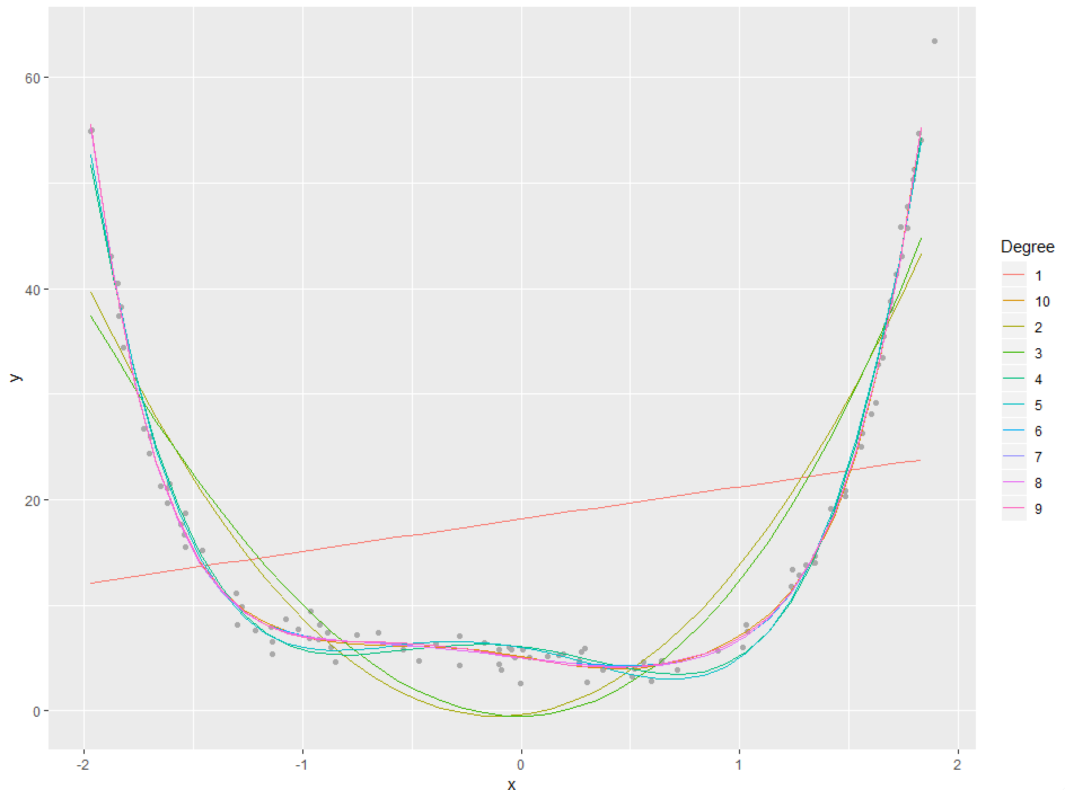
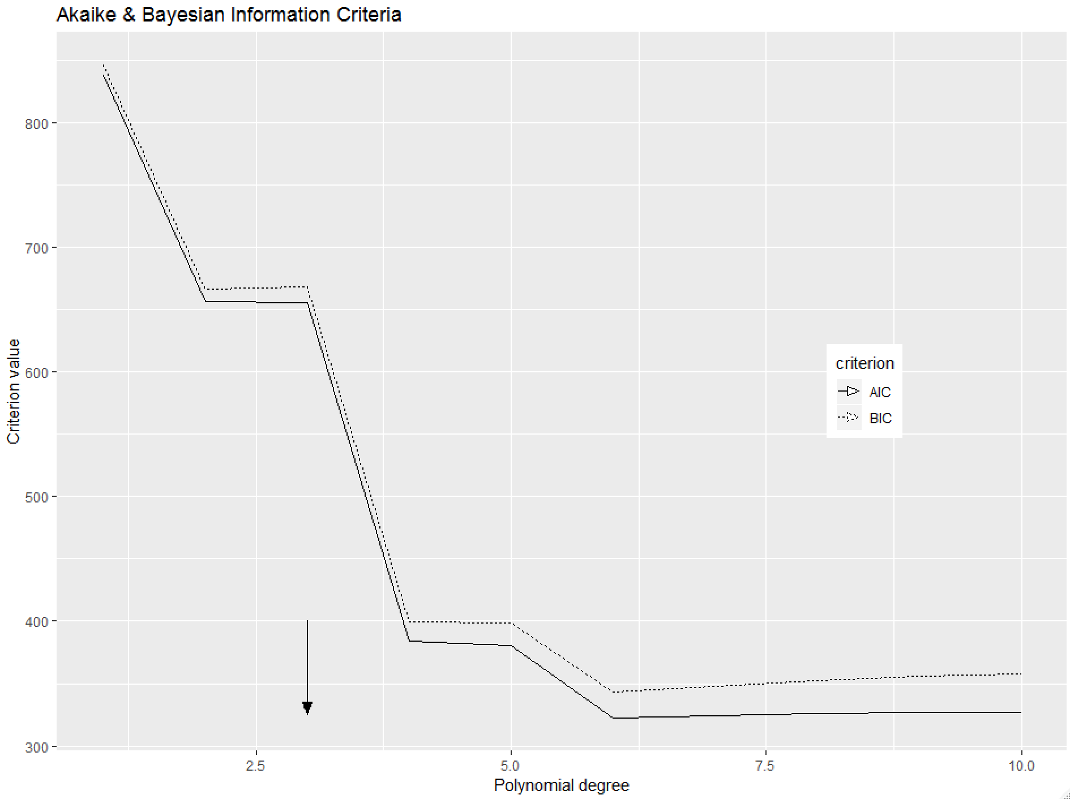
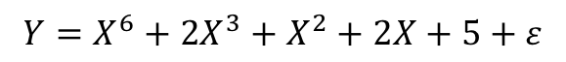
Practical examples: a good one (A variation on the previous one)
$$Y=X^{6}+2X^{3}+X^{2}+2X+5+ε$$
$$ε \sim 𝒩(0,1)$$

Slide 24
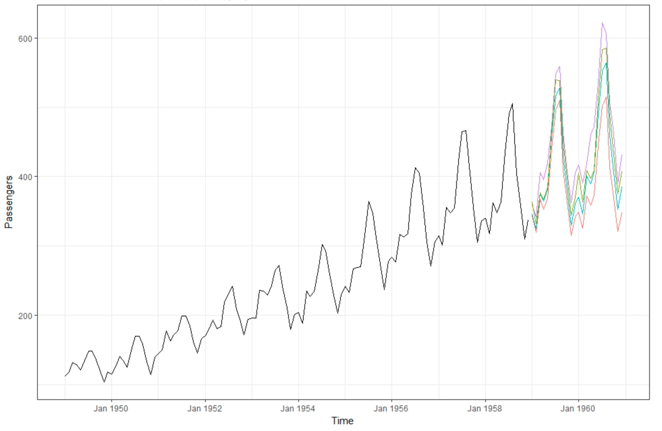
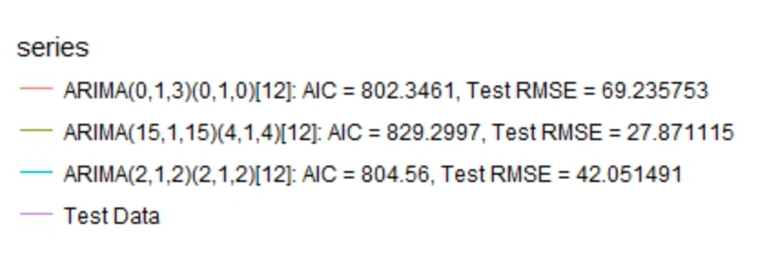
Practical examples: Hmmm…are we sure this always works?
Possible explanations:
Air Passengers is a highly regular and complex time series: Overfitting is not a problem
AIC (and BIC) works better on average for a large number of time series, but might not always be best for every single data set.
Is the forecast package accidentally reversing the AIC ? (See previous ‘+’ and ‘–’ definitions of AIC)

Slide 25
Explaining vs. Predicting: Some philosophy
Galit Shmueli: Explaining is not the same as predicting and!
For example univariate time series models don’t explain anything, but do a good job of forecasting
For explaining enough data is enough
For predicting there is no such thing as too much data
Using both forward looking data and backward looking data is fine for explaining
But leakage IS DEATH!!!! If you are predicting.

Slide 26
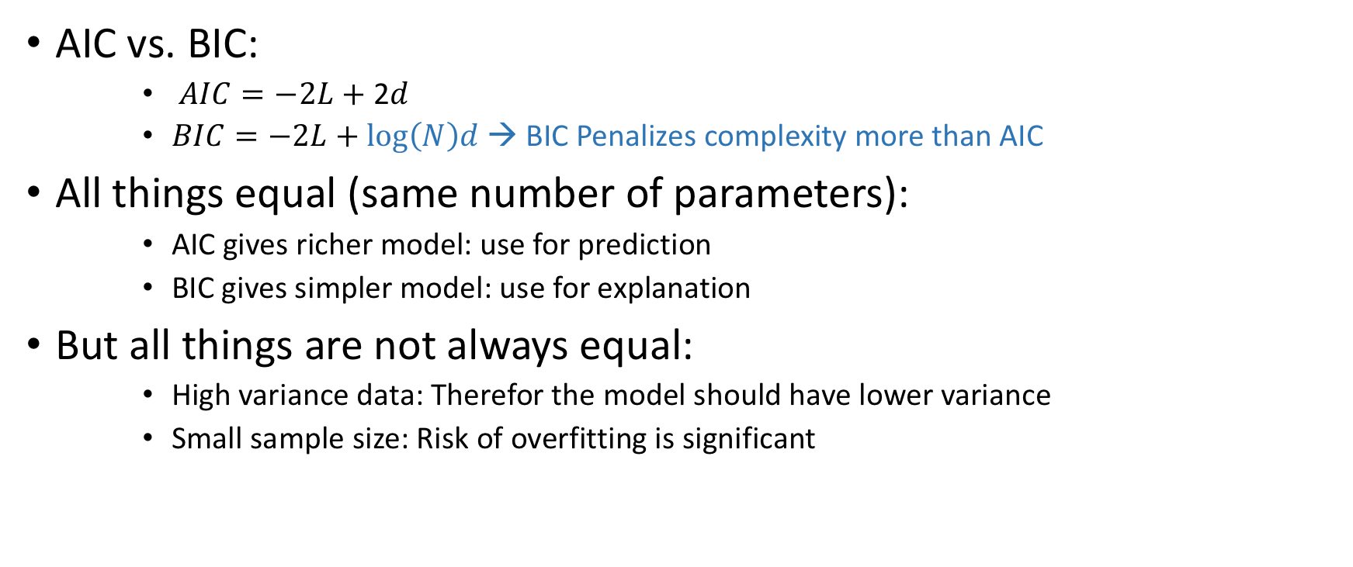
Explaining vs. Predicting: In the context of model selection
AIC vs. BIC:
$AIC=−2L+$ 2$d$
$BIC=−2L+\log\left(N\right)d$→ BIC Penalizes complexity more than AIC
All things equal (same number of parameters):
AIC gives richer model: use for prediction
BIC gives simpler model: use for explanation
But all things are not always equal:
High variance data: Therefor the model should have lower variance
Small sample size: Risk of overfitting is significant

Slide 27
Additional thoughts:
Are the AIC and BIC useful outside of time?
In theory they should be, so what aren’t they used more?
Model Selection vs Hyper-Parameter optimization?
Auto-ML: Bayesian optimization and its relatives
Where do AIC, BIC, VC, etc… fit into all this?

Slide 28
Additional thoughts:
A risky and tenuous prediction:
Some breakthrough in generalization theory will occur within the next few years along the lines of the VC Dimension (1971) or Weak Learnability, Strong Learnability and Boosting (1990).
This will end the reign of Neural Networks, in favor of a more theoretically grounded class of methods similar to SVM or XGBoost (So much for my year spent learning Tensorflow 😢…)

Slide 29
AIC, BIC and Alternatives to Out of Sample Testing – Chapter 7 ESL
終
The END
Nordstrom Data Science Reading Group – Skander Hannachi

